Slide 1

Irlanda
Mercado de TI
Profissionalizacao
e aspectos gerais

Slide 2
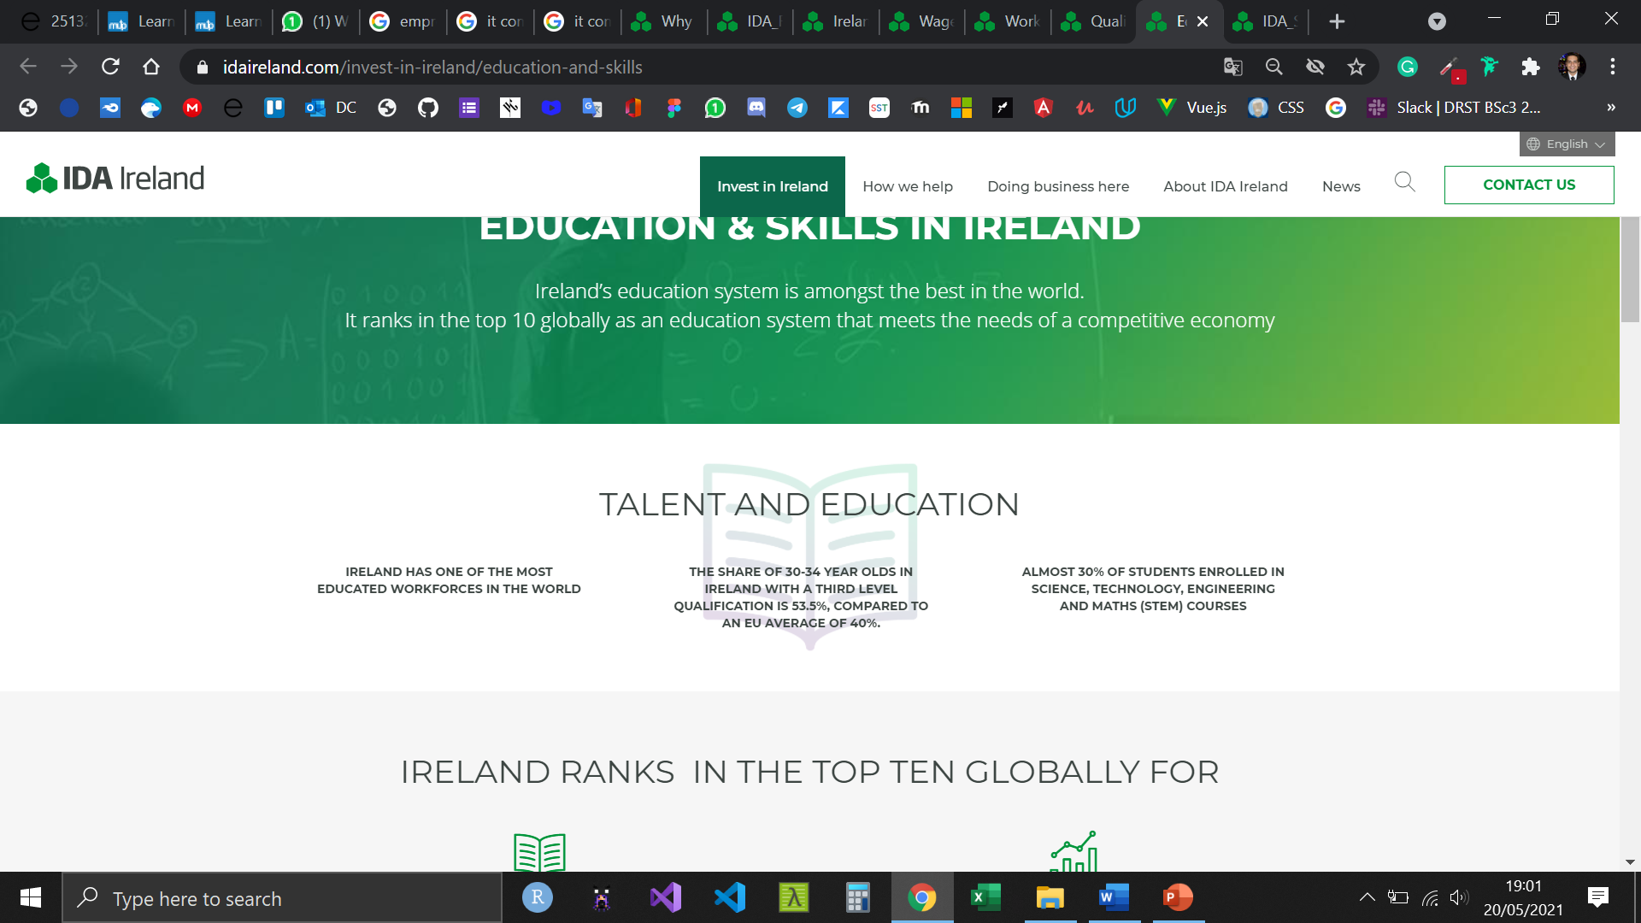
Educacao

Slide 3
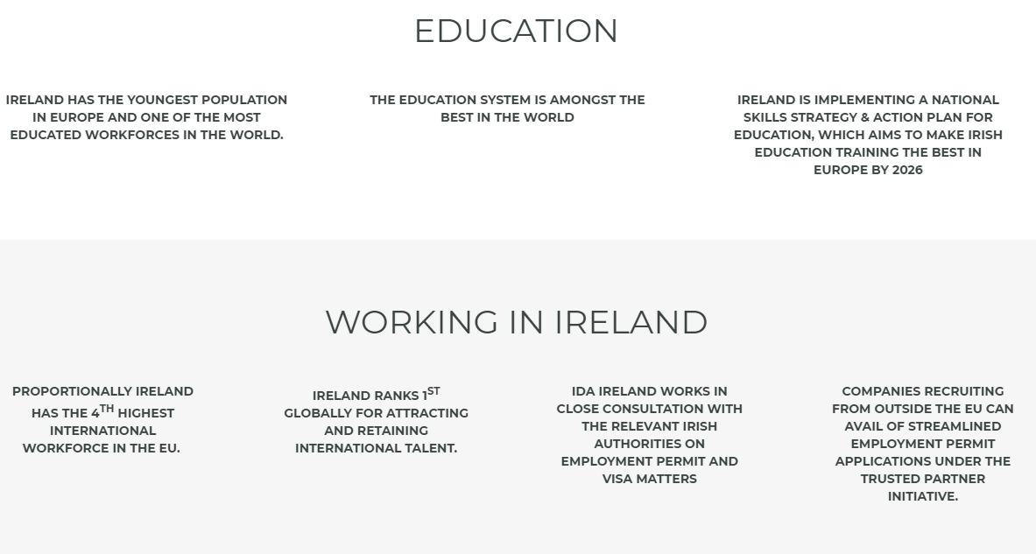

Slide 4
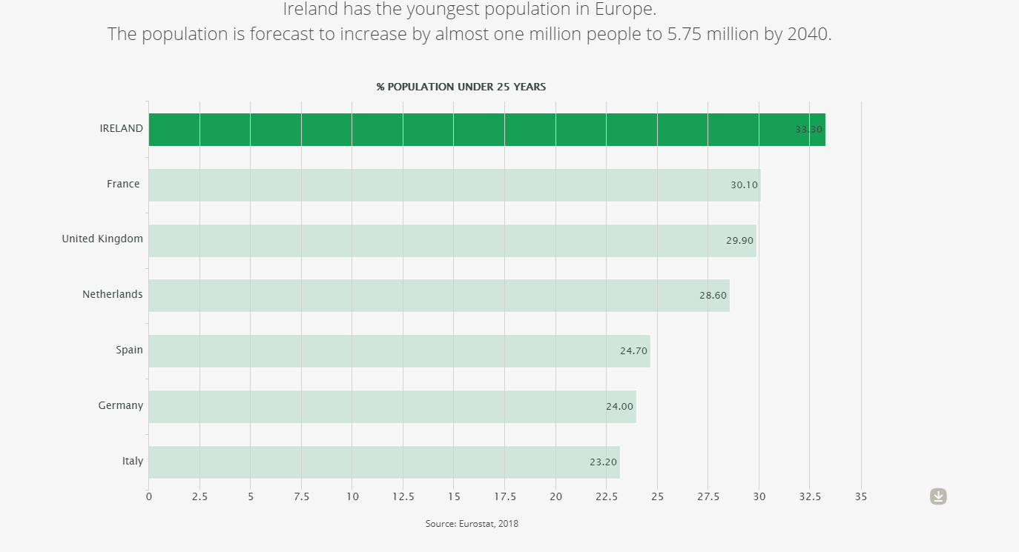

Slide 5
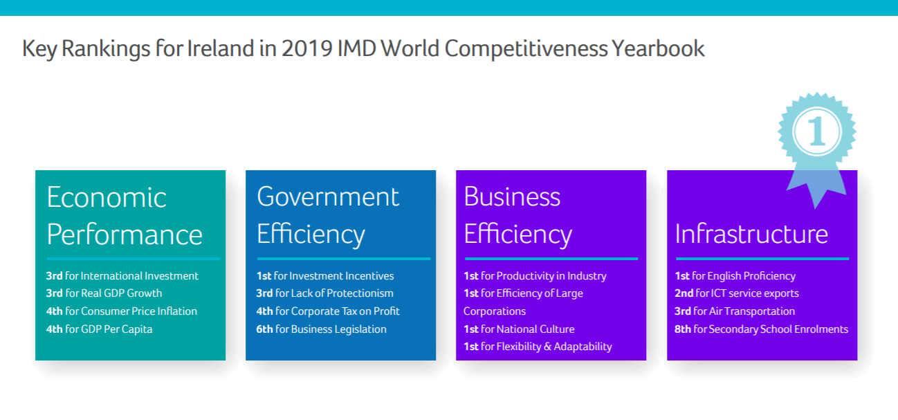
Competitividade & Produtividade

Slide 6
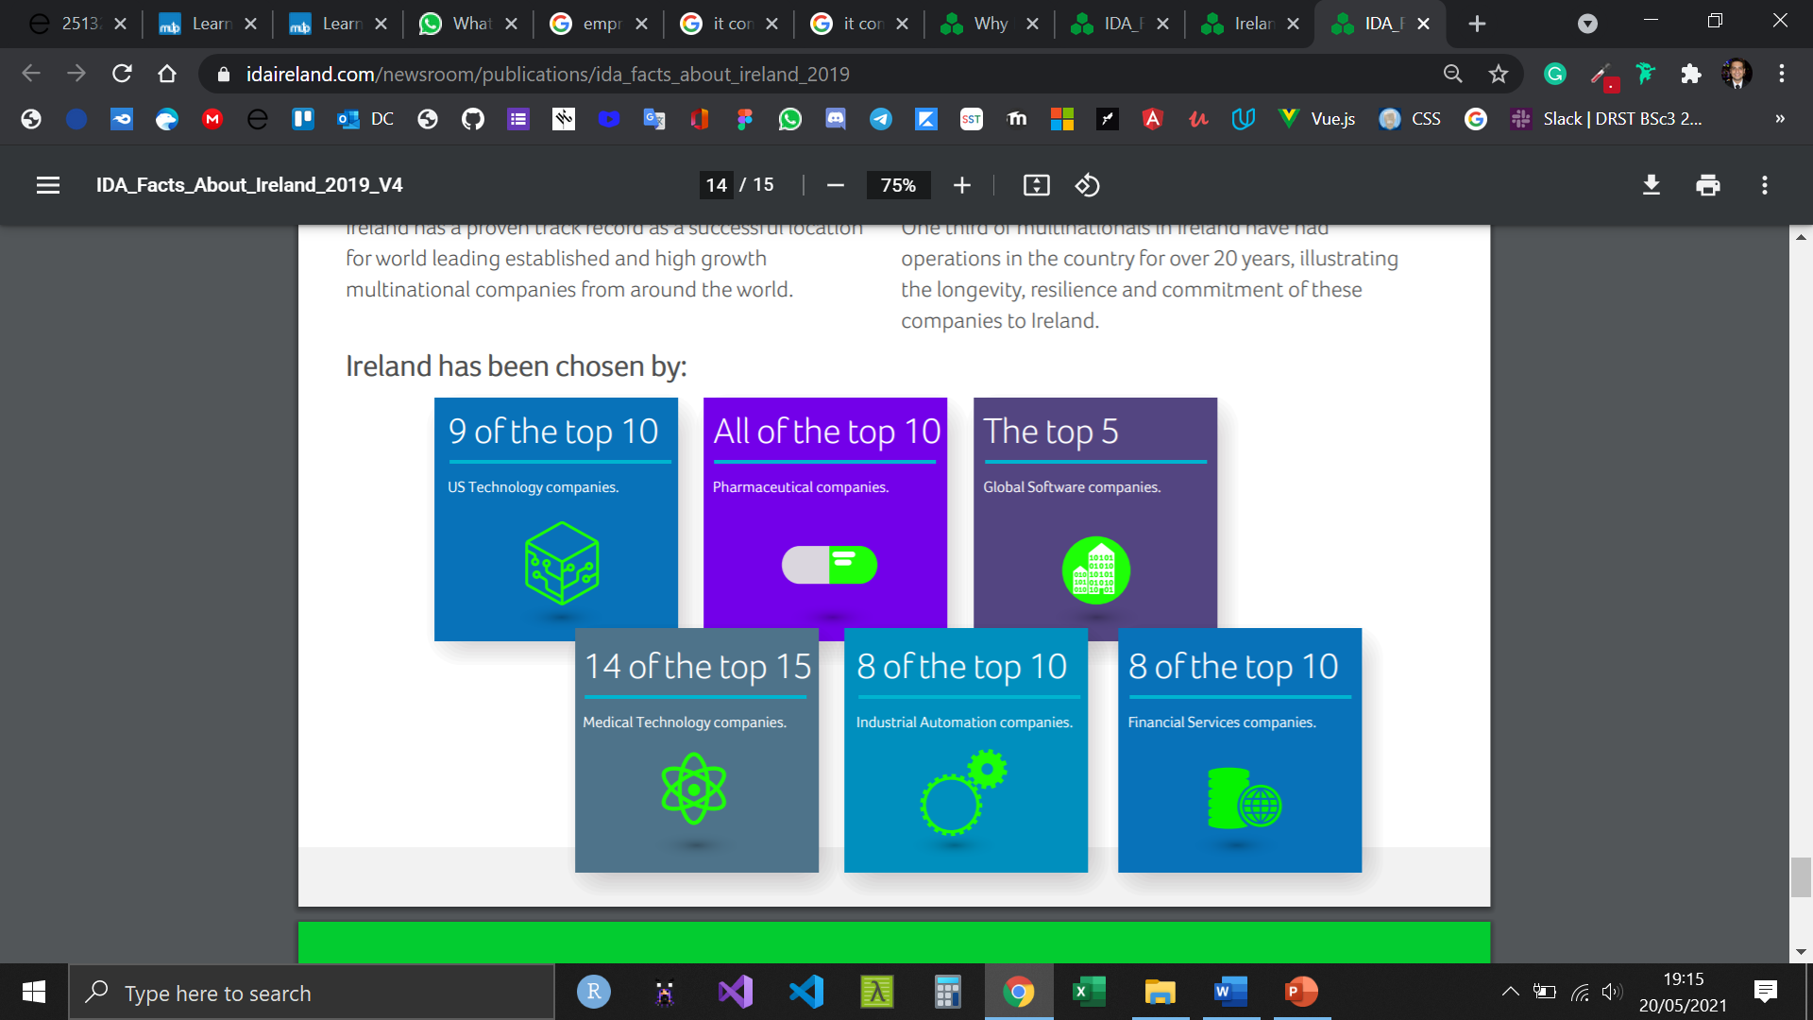
Track Record

Slide 7
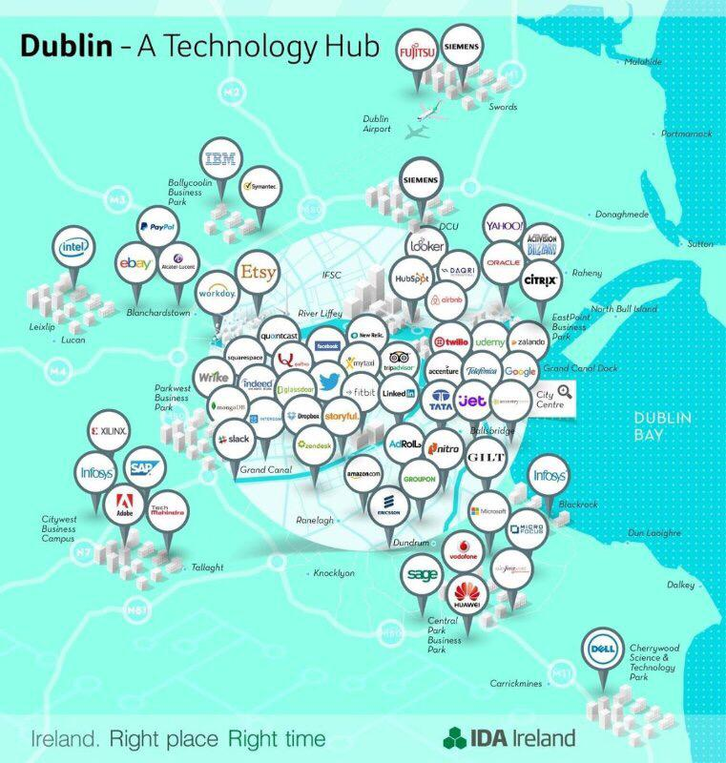

Slide 8
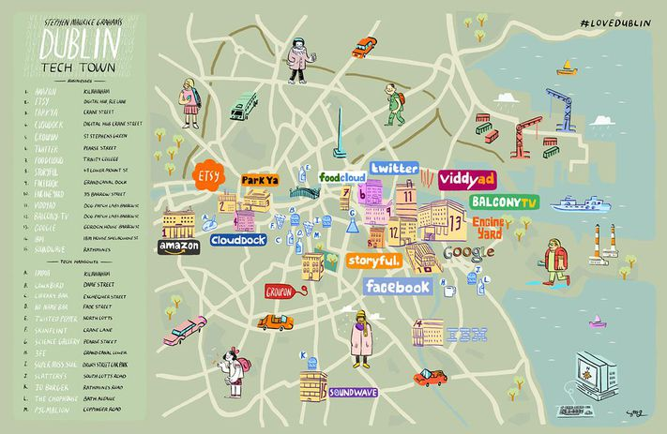

Slide 9
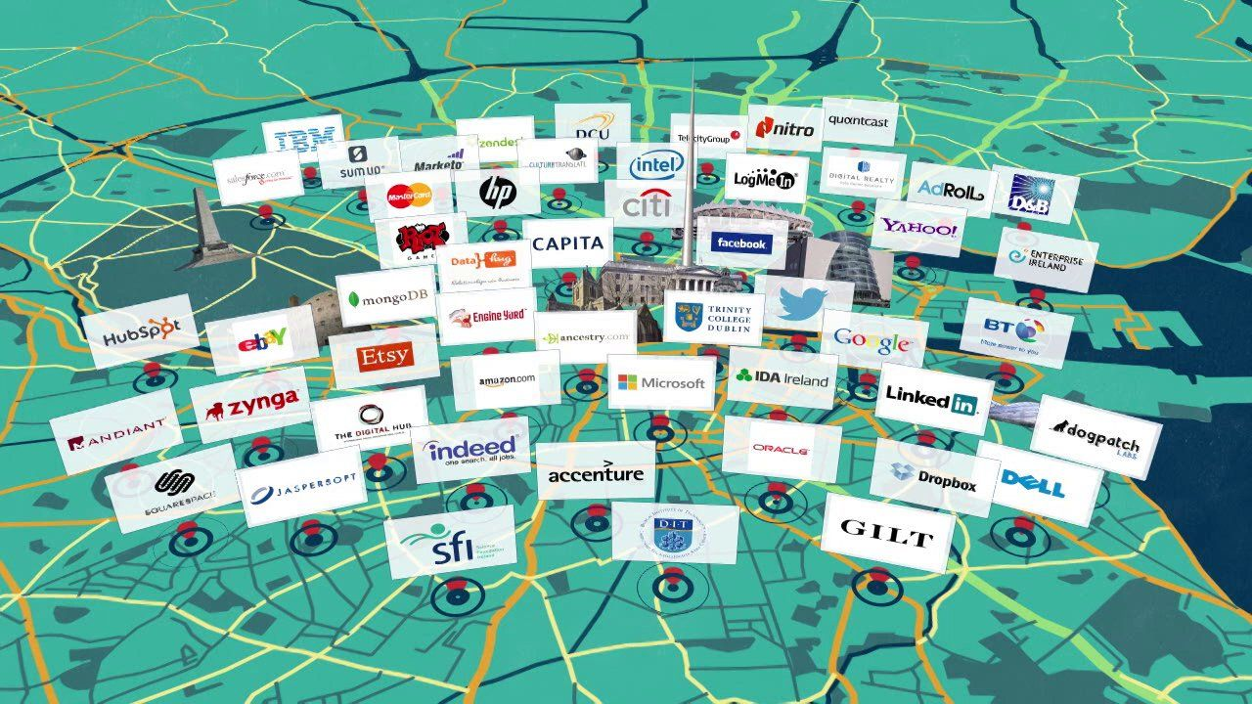

Slide 10
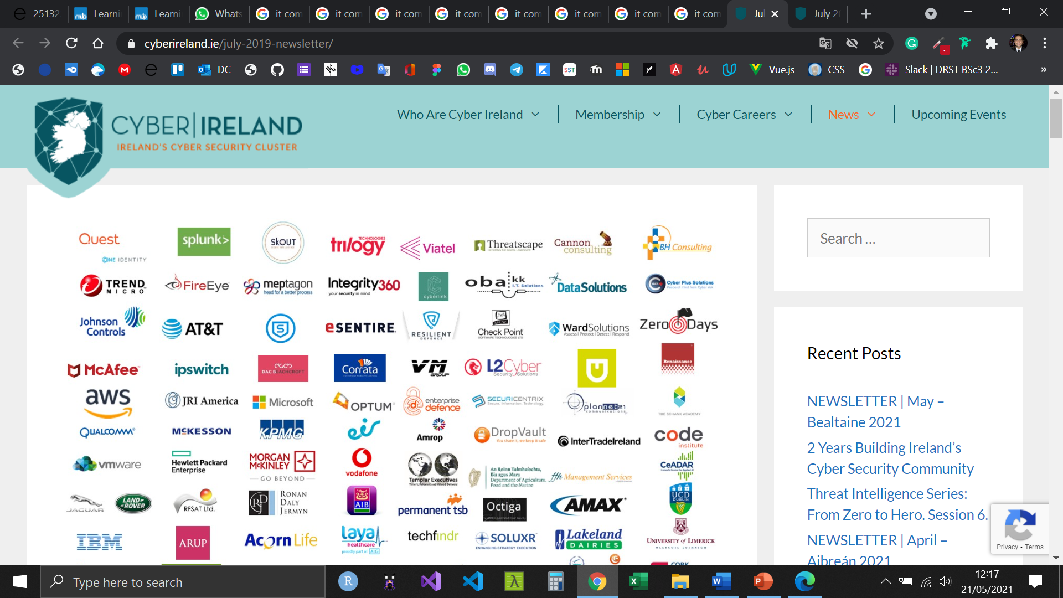
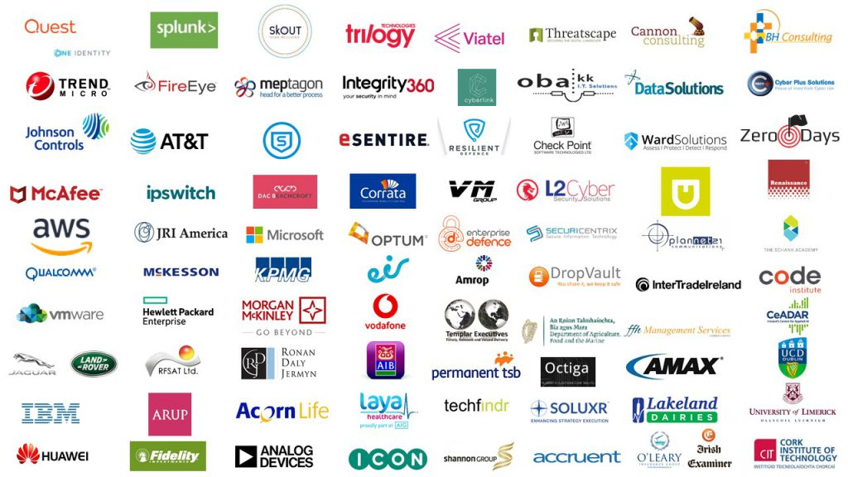
https://www.cyberireland.ie/
An incredible 80 organisations have already signed up to become members of Ireland’s Cyber Security

Slide 11
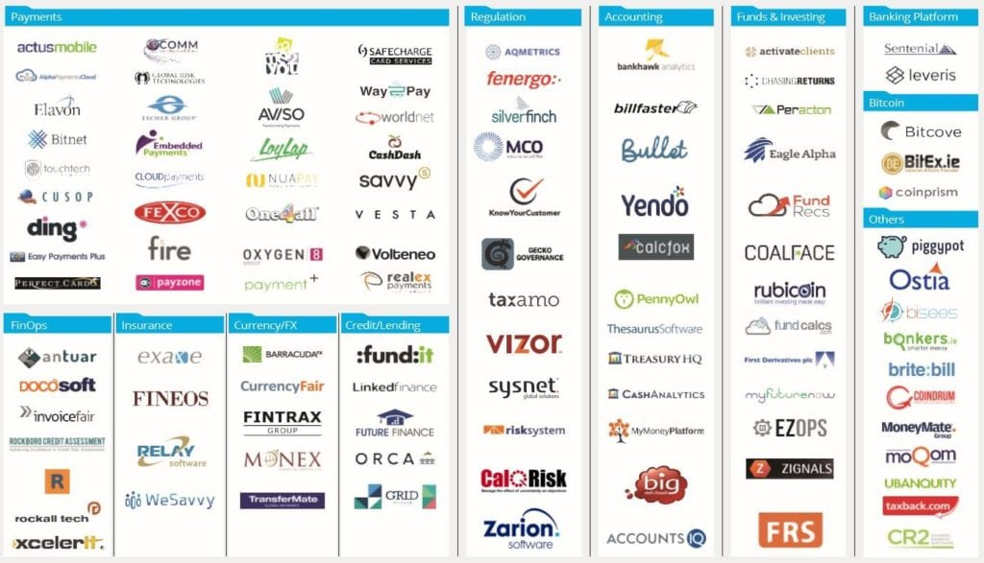
Fintech

Slide 12
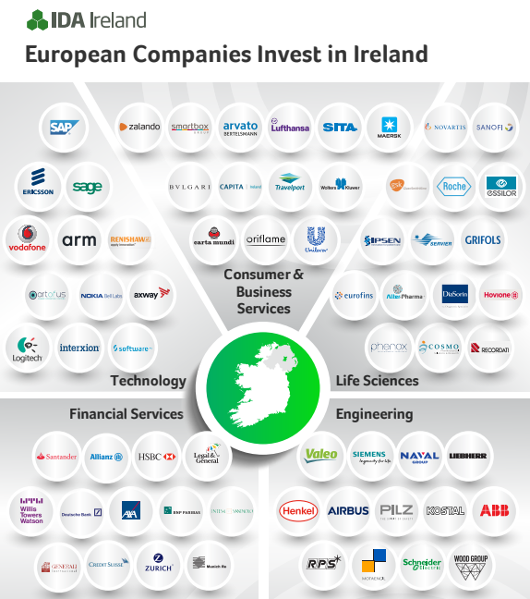

Slide 13
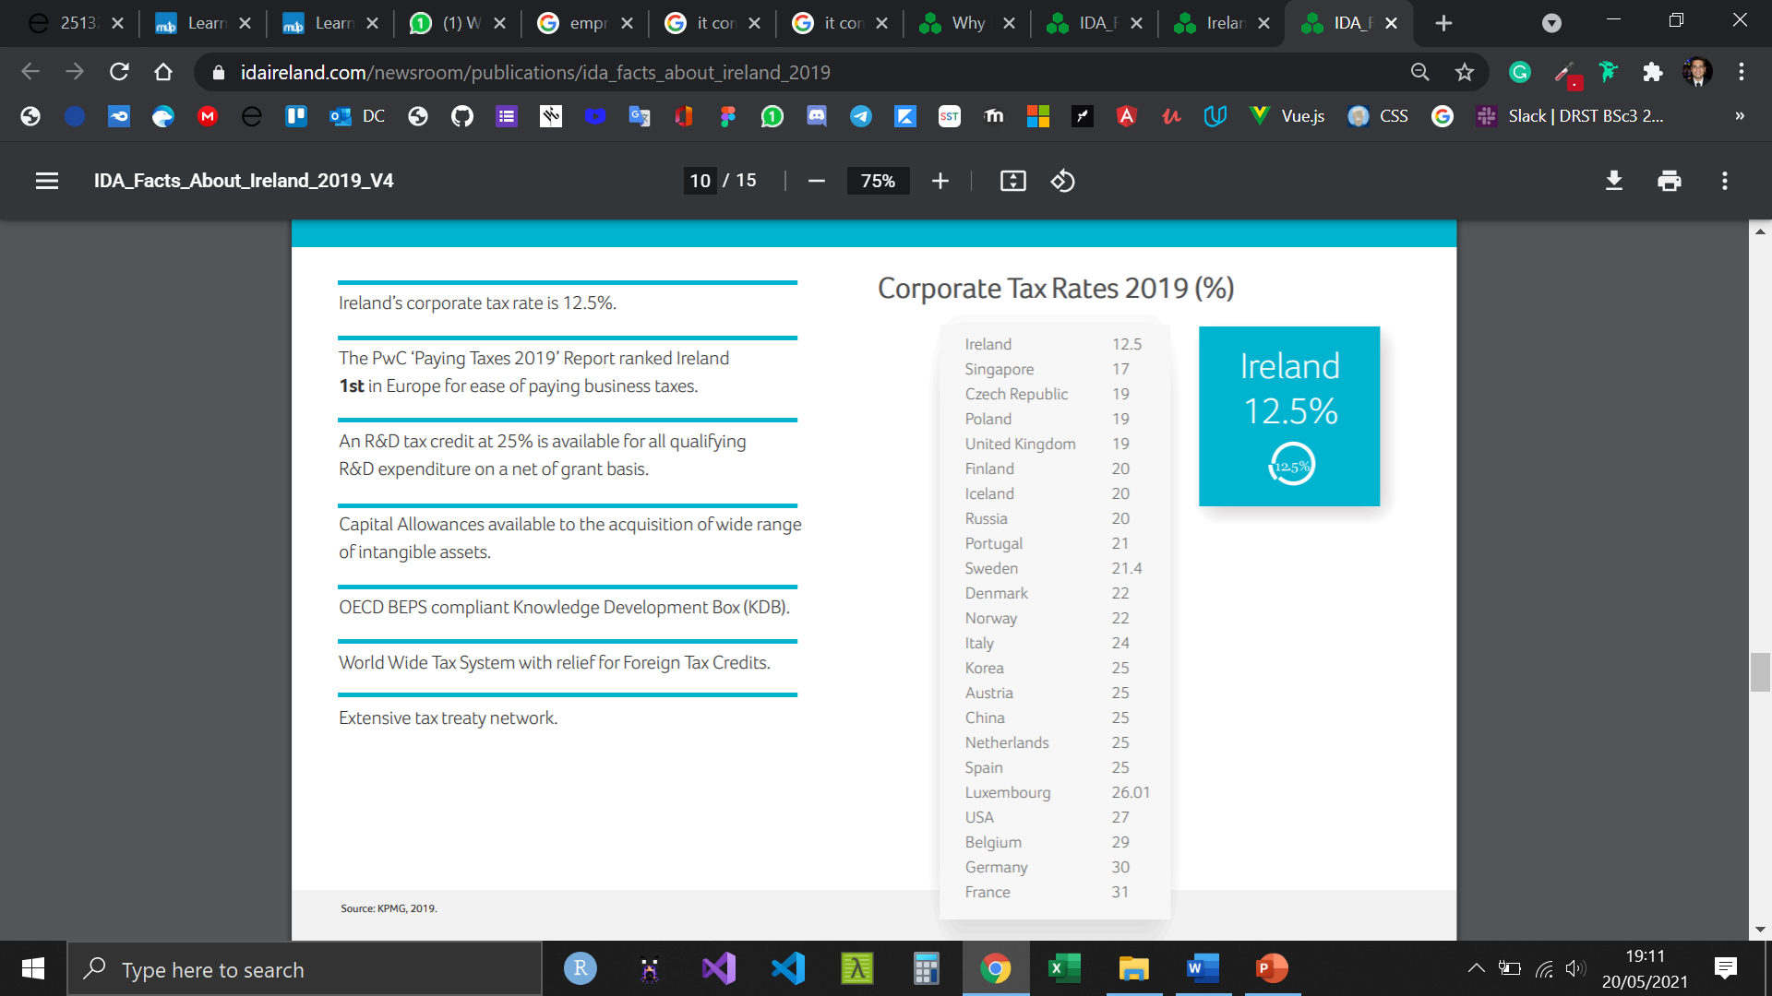
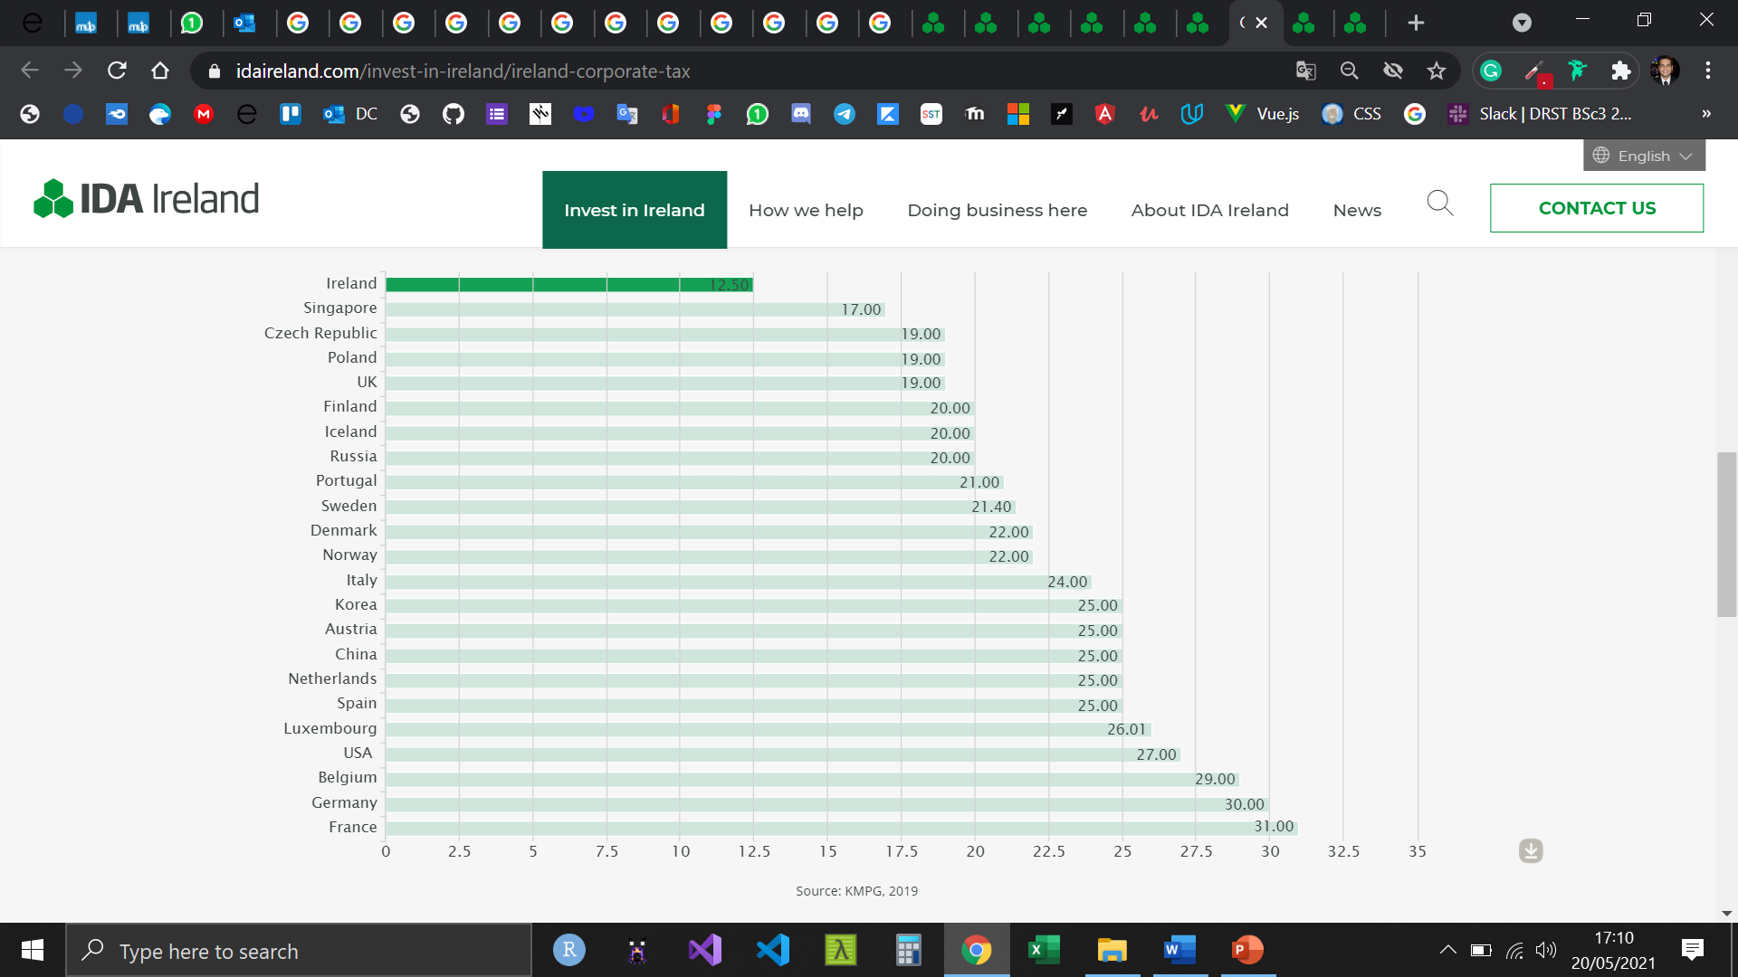
Corporate tax rates
Source: https://www.idaireland.com/invest-in-ireland/ireland-corporate-tax

Slide 14
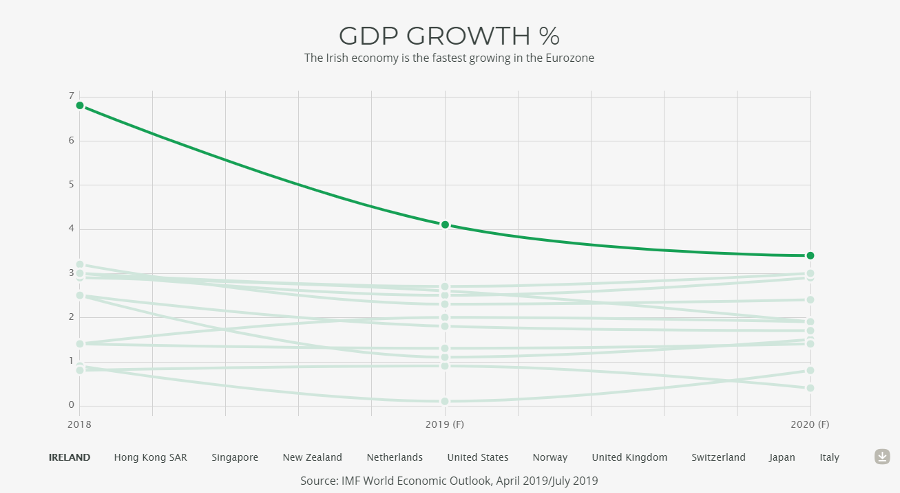

Slide 15
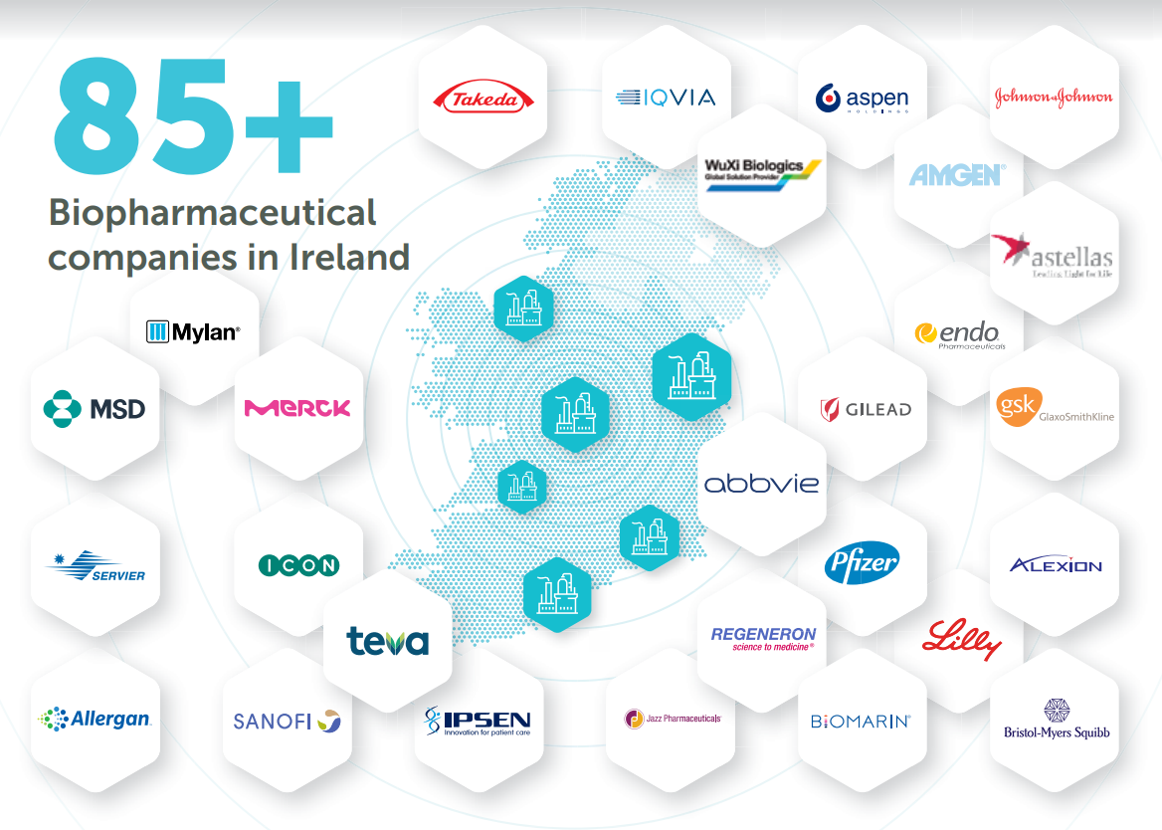
Industrias farmaceuticas

Slide 16
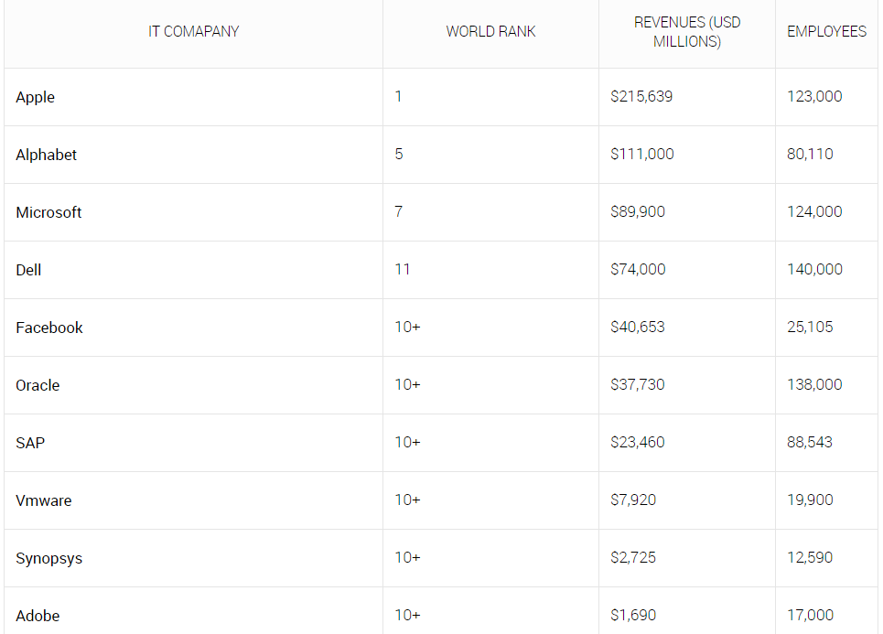
Top Information Technology(IT) companies in Ireland

Slide 17
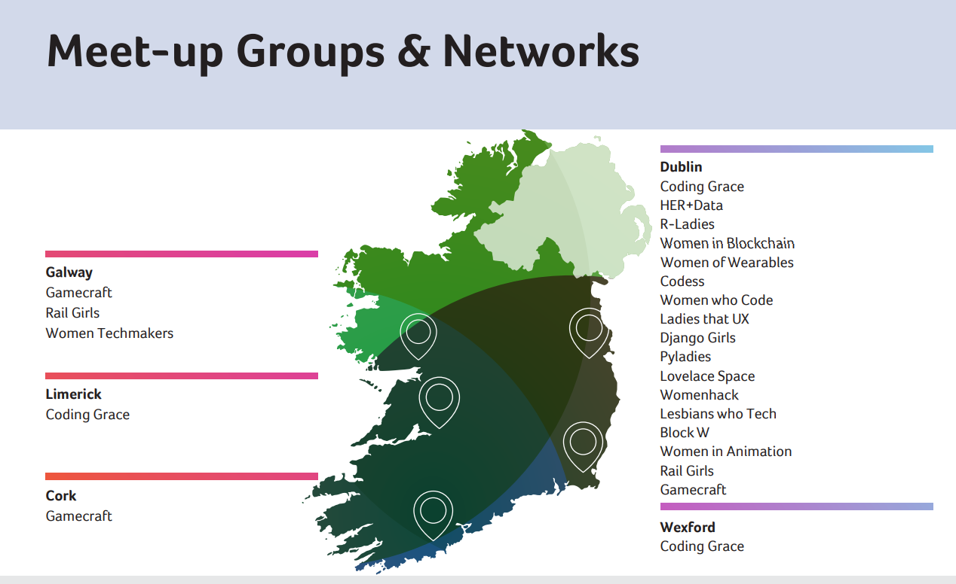

Slide 18
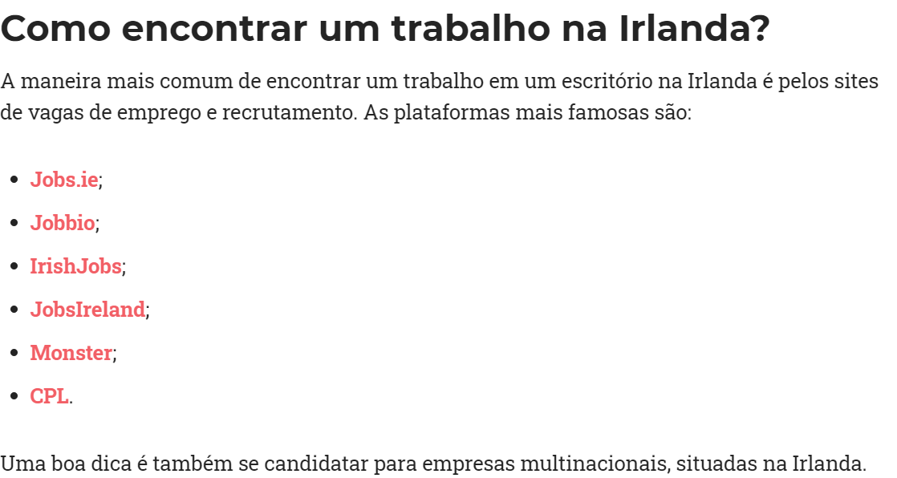
https://www.glassdoor.com.br/Sal%C3%A1rios/dublin-dublin-sal%C3%A1rio-SRCH_IL.0,6_IM1052_KO7,13.htm
https://www.payscale.com/research/IE/Job=Information_Technology_(IT)_Consultant/Salary

Slide 19
